Slide 1
Statistical-Modelling-with-Python
Present by
Kruti Kikani

Slide 2
Process of the project
Step 1
Grab live data from Citybike API
Step 3
Joining Data and vizulization
Step 4
Building a Model
Step 2
Connecting to Foursquare and Yelp APIs

Slide 3
Step 1: City bike API
Sent request to city bike
Parse through response to get details
Put parsed result into data frame

Slide 4
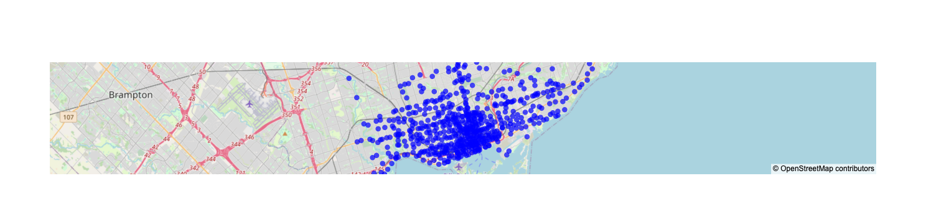
Step 1: City bike API
Sent request to city bike
Parse through response to get details
Put parsed result into data frame

Slide 5
Step 2 Connecting to Foursquare and Yelp APIs
Connected with Forsquare api and yelp api
Used API’s to find POI near each of the station
Find the detailed comparison regarding Yelp and Foursquare API, Pros of using both.
I have got only 5 places and create a final data frame to work on visualization and model building.

Slide 6
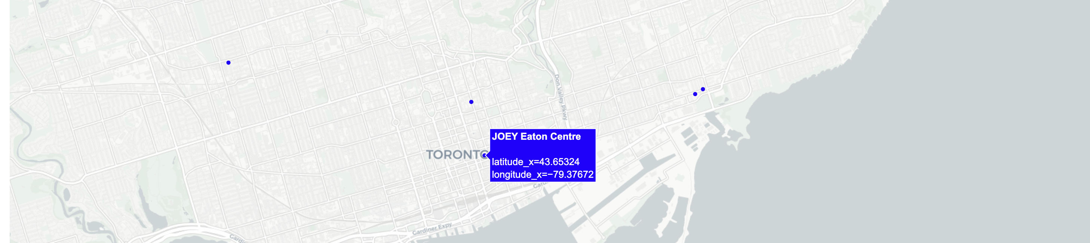
Step 3 Joining Data
I used python dataframe function to joint table together to create final table
I used different vizulization like map and chart and heat map, pair plot map
I have created database to keep all my dataframe in single loop. I have stored as .csv

Slide 7
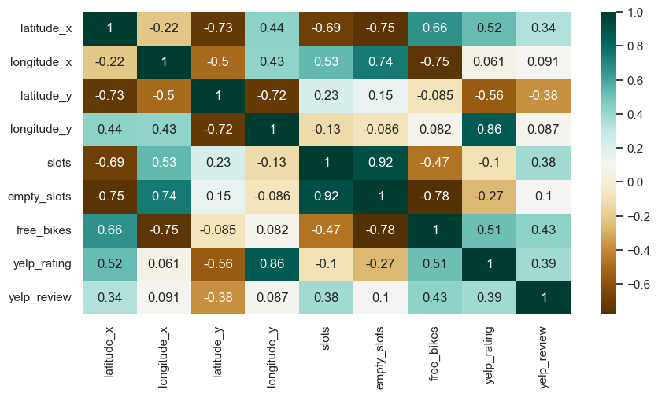
correlation matrix showing the correlation coefficients between different variables

Slide 8
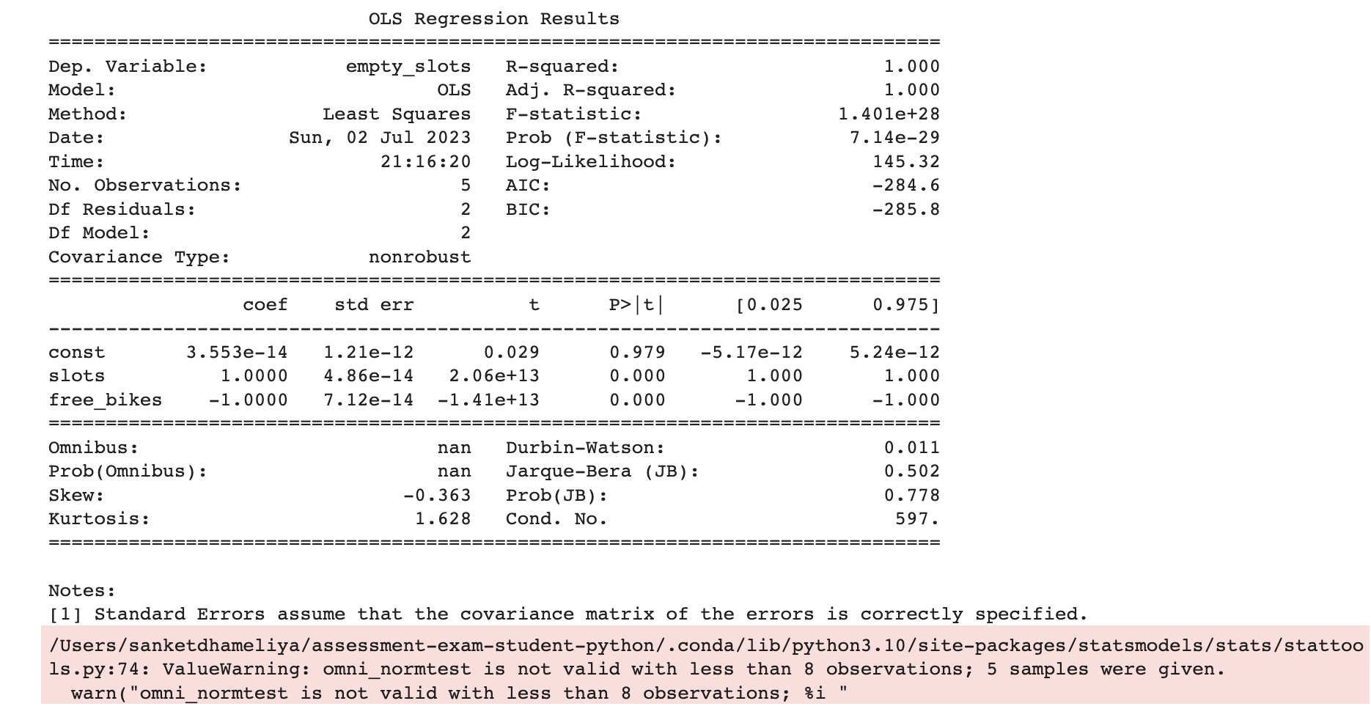
Step 4 Building a Model Rigression model
I used POI dataframe for modelbuilding
I created regression model
As result,I found:
R squared: is perfect fits with the data because it is 1.000
Adj. R squared: is also 1.000
T-value: in my data both the "slots" and "free_bikes" coefficients have t-values with very large magnitudes, indicating their high significance.
p-values: very small (close to 0), suggesting that both "slots" and "free_bikes" have a significant impact on the "empty_slots" variable.

Slide 9
Future goal:
For this project I would build a better model and visualization.
I would like to query the citybikes API for a larger dataset. I would also like to experiment with different POI data.
For this project, I will construct an improved model and create enhanced visualizations.
I would experiment with various modeling techniques, such as Linear Regression, Logistic Regression etc.S

Slide 10


